Slide 1
Intput image
Output image

Slide 2

(x_start,y_start)
Input image
Output image

Slide 3
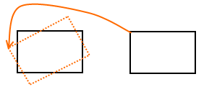

Y
Y’
X’
X
Source
Output
R1
(X,Y)
R2

